Slide 1
Chapter 11: Elliptic Curve Cryptography

Slide 2
Elliptic Curves
Elliptic curves have been studied, apart from cryptographic applications, for well over a century.
As with other asymmetric algorithms, the mathematics have been a part of number theory and algebra, long before being applied to cryptography.

Slide 3
Elliptic Curves in Cryptography
The use of elliptic curves for cryptographic purposes was first described in 1985 by Victor Miller (IBM) and Neil Koblitz (University of Washington).
The security of elliptic curve cryptography (ECC) is based on the fact that finding the discrete logarithm of a random elliptic curve element with respect to a publicly known base point is so difficult that it is impractical.

Slide 4
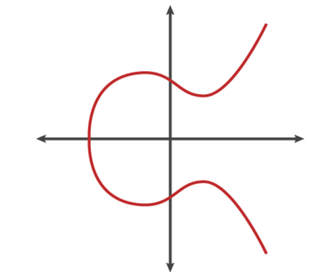
ECC Basics
An elliptic curve is the set of points that satisfy a specific mathematical equation. The equation for an elliptic curve looks something like this:
  y² = x³ + Ax + B
And graphed like this:
Another way to describe an elliptic curve is this: it is the set of points that satisfy an equation that has two variables in the second degree and one variable in the third degree. The first thing you should notice from the graph is the horizontal symmetry. Any point on the curve can be reflected about the x-axis without changing the shape of the curve.

Slide 5
ECC Details
The members of the elliptic curve field are integer points on the elliptic curve. You can perform addition with points on an elliptic curve. Throughout this chapter, as well as most of the literature on elliptic curve, we consider two points, P and Q.
The negative of a point P = (xP,yP) is its reflection in the x-axis: the point –P is (xP,–yP). Notice that for each point P on an elliptic curve, the point –P is also on the curve.
Suppose that P and Q are two distinct points on an elliptic curve, and assume that P is not merely the inverse of Q. To add the points P and Q, a line is drawn through the two points. This line will intersect the elliptic curve in exactly one more point, called –R. The point –R is reflected in the x-axis to the point R.
The law for addition in an elliptic curve group is P + Q = R.

Slide 6
ECC Details
The line through P and –P is a vertical line that does not intersect the elliptic curve at a third point; thus the points P and –P cannot be added as previously.
This is why the elliptic curve group includes the point at infinity O. By definition, P + (–P) = O.
As a result of this equation, P + O = P in the elliptic curve group. O is called the additive identity of the elliptic curve group; all elliptic curves have an additive identity.

Slide 7
Elliptic Curves and Cryptography
To use ECC, all parties must agree on all the elements defining the elliptic curve—that is, the domain parameters of the scheme. The field is defined by p in the prime case and the pair m and f in the binary case. To focus on the prime case (the simpler), the field is defined by some prime number p. The elliptic curve is defined by the constants A and B used in this equation:
  y² = x³ + Ax + B
Finally, the cyclic subgroup is defined by its generator (a base point) G.
The elliptic curve are the points defined by the equation with an extra point O, which is called the point at infinity. Keep in mind that point O is the identity element for this group.

Slide 8
Elliptic Curves and Cryptography
Given a point P = (x,y) and a positive integer n, we define
[n]P = P + P + ... + P (n times). The order of a point P = (x,y) is the smallest positive integer n such that [n]P = O.
We denote by < P > the group generated by P. In other words,
< P > = {O, P, P+P, P+P+P, . . .}.
Now that you have a group defined by an elliptic curve, the security of ECC is provided by the elliptic curve discrete logarithm problem (ECDLP).
The ECDLP is this: Given an elliptic curve C defined over F_{θ} and two points P, Q that are elements of the curve C, find an integer x such that Q = xP.

Slide 9
ECC Variations
As you can see, elliptic curves form groups, and those groups can be used like any other algebraic group. The practical implication of this is that you can adapt various algorithms to elliptic curve groups.
There are many permutations of elliptic curve cryptography, including
Elliptic Curve Diffie-Hellman (used for key exchange) (ECDH)
Elliptic Curve Digital Signature Algorithm (ECDSA)
Elliptic Curve MQV key agreement protocol
Elliptic Curve Integrated Encryption Scheme (ECIES)

